Slide 1
VBA Homework-Moderate
Shenglin Ye

Slide 2
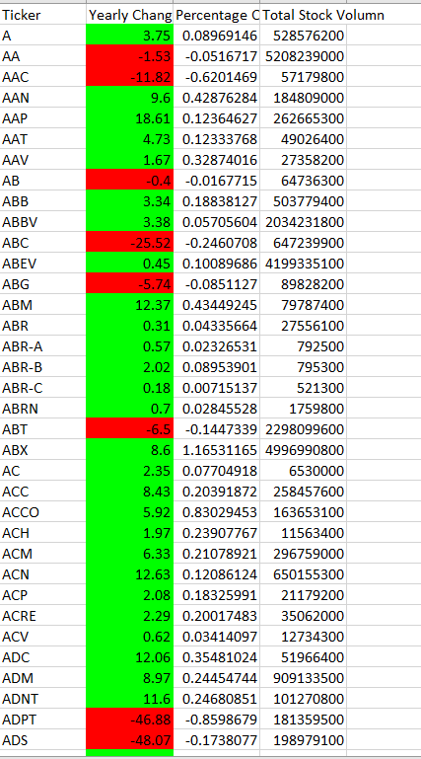
2016

Slide 3
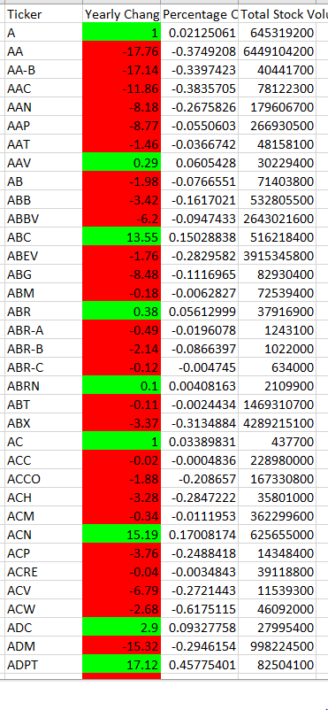
2015

Slide 4
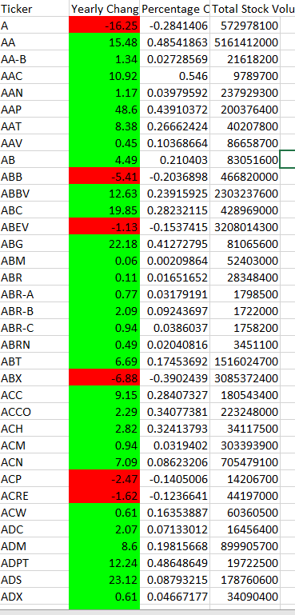
2014

